Slide 1
E-R Model Examples
Rushali Patil

Slide 2
Example 1- Company Database
The company database keeps track of a company’s employees, departments, and projects. The database designer stated following description of the “miniworld”:
The company is organized into departments. Each department has a unique name, a unique number and a particular employee who manages the department. We keep track of the start date when the employee began managing the department. A department may have several locations.
A department controls a number of projects, each of which has a unique name, a unique number and a single location.
We store each employee’s name, social security number, address, salary, sex and birth date. An employee is assigned to one department but may work on several projects, which are not necessarily controlled by the same department. We keep track of the number of hours per week that an employee works on each project. We also keep track of the direct supervisor of each employee.
We want to keep track of the dependents of each employee for insurance process. We keep each dependent’s first name, sex, birth date and relationship to the employee.

Slide 3
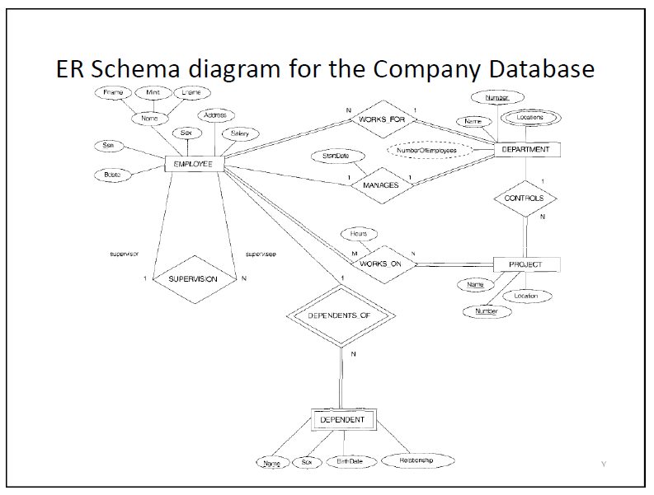
Solution

